Slide 1
Majlis Ansarullah
Monthly Meeting
October 2016
This slide deck contains images licensed for the purpose of this presentation only.
No one is permitted to use the images for any other use, without prior permission.

Slide 2
AGENDA
Recitation of the Holy Qur’an (20:133)
Pledge
Reminder: Why Recite the Holy Qur’an Everyday
Monthly topic: Being Attentive to the Moral Training of Our Children
Health topic: Healthy Vision
National Reminders/Announcements
Local Reminders/Announcements
Dua

Slide 3
Why read the Holy Qur’an regularly?
THE MEANING OF HOLY Qur’an ARE UNFOLDED AS DEMAND IS CREATED
The meanings of Holy Qur’an are unfolded as demand is created according to the changing times and stand guard like well-armed soldier against the insinuations and aspersions cast in every age. Had the Qur’an been limited in extent regarding that which it comprises of solid facts and subtle realities it could not have been deemed as that perfect miracle.
(Roohani Khaza’in, vol 3, page 255)

Slide 4
Watching Our Congregational Salat!
Even a Blind Man
Abu Hurayrah (may Allah be pleased with him) reported that a blind man said to the Prophet (saw) “O Messenger of Allah, I have no guide to lead me to the mosque (to attend the congregational Prayer).” He asked the Prophet (saw) for permission to pray in his house and the Prophet (saw) permitted him. Then, when he turned to go, the Prophet (saw) called him and said: “Do you hear the call to prayer?” The blind man said “yes.” The Prophet (saw) then said: “Then respond to it [by coming to the mosque]!”
[Muslim]

Slide 5
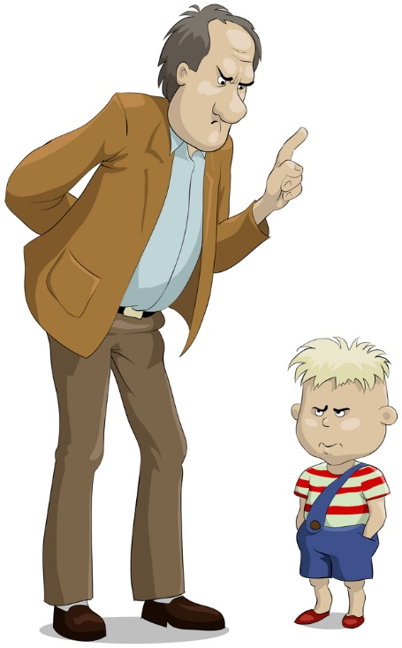
Moral Training of Children

Slide 6

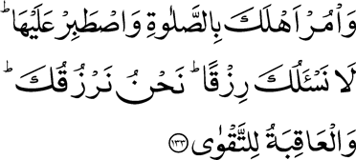
Click to listen the recitation
[20:133] And enjoin Prayer on thy people, and be constant therein. We ask thee not for provision; it is We that provide for thee. And the end is for righteousness.

Slide 7
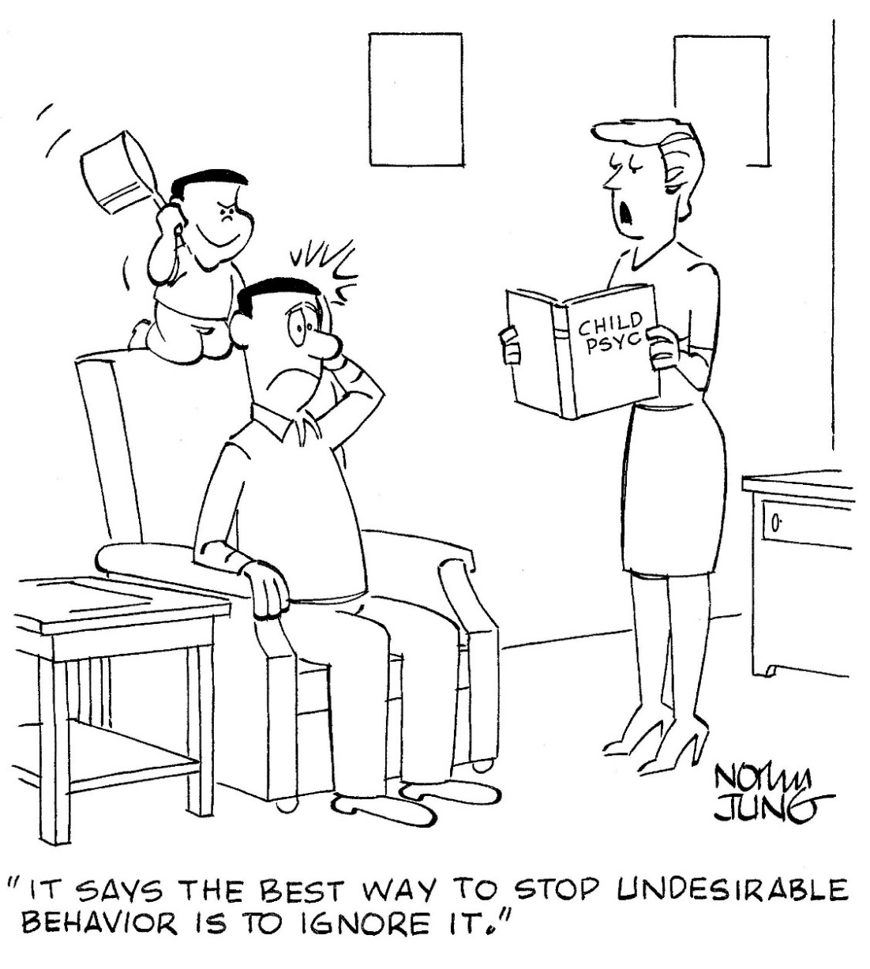
What does it mean to constantly remind your family for Prayers?
Share your thoughts!

Slide 8
Guidance from Hazrat Musleh Mau’ud (ra)
Hazrat Musleh Mau’ud (ra) said: “Congregational Prayer—in my view—is the most important intervention to teach children good morals and habits. Children should be trained to offer Salat in congregation. In my view, there is no bigger enemy of a child than those parents who do not inculcate the habit of offering congregational Prayer in their children. While a grown up who fails to offer congregational Salat is a hypocrite, parents who don’t inculcate this habit in their children are their murderers. It is impossible for a child to sustain irreparable moral damage if parents help them develop a habit of offering Prayers in congregation.”
Nazarat Islah-o-Irshad

Slide 9

Discussion I
After school and baseball practice (Thursday), your son comes home tired and exhausted. Along with a lot of homework, he laments that he has a big paper due for History on Friday, a class where he is running a C. This Saturday, he must also participate in the Waqfe Nau Ijtima, for which he still has to memorize a Ruku of Surah Al-Kahf. How would you help him prioritize his Thursday evening?

Slide 10
Option 1: Advise him to combine his Maghrib/Isha Prayers, then work on his school homework. Save the Ijtima prep for Friday night.
Option 2: Advise him to separate his Maghrib/Isha Prayers, read a portion of the Holy Qur’an, and then work on his school homework. Save the Ijtima prep for Friday night.
Option 3: Keep to your routine of going to the masjid for Maghrib prayers. Advise him to read a portion of the Holy Qur’an, then do some Ijtima prep. The remainder of the night should go towards his school work.
Option 4: Any other response?

Slide 11
From the Writings of Hazrat Mirza Bashir Ahmad (ra)
But it is a pity that most of the parents disregard this golden principle with the result that many children, far from being better off than their parents, are brought up, in such a condition as gives the impression of a dead baby having been born to a live person. Such parents feed and dress their children well and to some extent also mind their secular education, as it provides them with means of economic well-being, but they generally disregard their moral discipline as if it were something unimportant. On the contrary, moral training or discipline is infinitely more important than secular education and certainly has a greater moral value and status. An educationally less qualified but morally better disciplined person endowed with qualities of industry, truthfulness, honesty, self-sacrifice and pleasing manners is far superior to the man carrying the donkey-load of knowledge but totally bereft of qualities of moral excellence.
Qamarul Anbiya (Moon of the Prophets)

Slide 12

Discussion II
Your eleven-year old daughter went to bed late last night because your parents had visited for dinner and they didn’t leave until 10pm. With her school starting at 8am in the morning, your wife pleads with you not to wake her for Fajr (at 6am) in the morning. She knows your daughter will not be able to fall back to sleep after Fajr and she will be miserable for the rest of the day. How would you respond to your wife?

Slide 13
Option 1: Let it go this time. Commit to waking her up for Fajr the subsequent morning.
Option 2: Set an alarm in your daughter’s room for Fajr time. If she wakes up, great.
Option 3: Tell your wife you plan to wake your daughter as you normally do, on time.
Option 4: Any other response?

Slide 14
Sayings of the Holy Prophet (saw)
Hadith 1: The Prophet Muhammad (saw) said: Allah will ask every caretaker about the people under his care, and the man will be asked about the people of his household.
(Nasa’i, Abu Da’ud)
Hadith 2: The Prophet Muhammad (saw) said: Every one of your (people) is responsible, and everyone is responsible for whatever falls under his responsibility. A man is like a shepherd of his own family, and he is responsible for them.
(Bukhari and Muslim)

Slide 15

Discussion III
A family goes to the museum on their daughter’s 3rd birthday. The family also includes two sons ages 16 and 10.
The family is confronted by this sign at the entrance: “Adults ($29), Children 3-15 ($20), Under 3 is Free.”

Slide 16
Option 1: The father should pay for 3 adults and 2 children.
Option 2: The father should pay for 2 adults and 2 children. When he gets home, pay some Sadaqa.
Option 3: The mother should divert the boys’ attention and pay for 2 adults and 2 children.
Option 4: Any other response?

Slide 17
Guidance from Hazrat Musleh Mau’ud (ra)
Do not lie to a child nor be peevish or arrogant with it. It will certainly imitate you. It is the parents who teach a child lying. The mother does something in the child’s presence but denies having done it when asked by the father. Thus the child learns to lie. I certainly do not mean that parents are permitted to misbehave in the absence of the child. What I mean is that if they cannot help doing such things, they should try to be circumspect, at least, in the presence of children to save the younger generation from such evils.
Way of Seekers

Slide 18
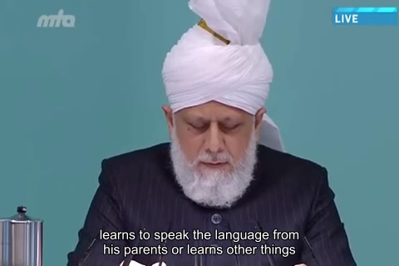
A Short Video from Friday Sermon, Dec 13, 2013

Slide 19
Translation of the Video
It is due to imitation and environment that a child learns to speak the language from his parents or learns other things. He learns good behaviors and after learning those good behaviors, a child develops high morals. If parents are righteous, offer their prayers, read the Holy Qur’an and recite it, live with mutual love and affection, and despise falsehood, then the child will be influenced by the parents’ virtues and will adopt the same. However, if falsehood, confrontations, disdainful discussions to ridicule each other at home, and not being mindful of the Jama’at’s dignity and honor, if all this occur; or when child observes any such type of vices, then as a result of the inherent nature of imitating or as a result of the environment, he also picks up these vices. When he is outside of home, whatever he observes in the environment and among his friends, he makes an effort to imitate that. This is why I repeatedly call the attention of the parents that they should be watchful of the child’s environment outside of home. And they should also be vigilant of what they do at home; any TV programs they watch, or their use of the Internet. Then another matter requiring attention is that age of the child’s training starts from the early childhood. You should remember this. Do not assume that moral training will begin when child grows up. Even when the child is of 2 or 3 years old, it’s the age for moral training. As I said that child learns from his parents and elders at home and imitates them. Parents should never assume that the child is yet small so what would he know. The child knows everything and he is observing every act of his parents, and unconsciously all this embedding in in his mind.

Slide 20
اپنے جائزے لیں -
Self-analyze yourself
Where do we stand?
In the past week, how many times did you
put your worldly affairs ahead of Salat at the appointed time?
allow external influence to keep you from training your family?
not twist the rules to your benefit?
Add the three numbers together.
(Keep it to yourself... the “score” is for you!)

Slide 21
How to Improve?
اپنے اندر پاک تبدیلیاں پیدا کریں -
Bring about pious changes in yourself
0
Combined Score
5+
Masha’allah. Keep scrutinizing your actions.
Identify what fault is plaguing you – pray and resolve to act differently.
Your children and grandchildren watch what you do and will copy you in the future. Don’t let your faults become your legacy.

Slide 22

Health Topic: Healthy vision

Slide 23


Is it Just part of growing up?
In your 40s certain changes in vision are considered normal e.g. need reading glasses
We are also at higher risk of developing age-related eye diseases and conditions
These conditions are age-related macular degeneration, cataract, diabetic eye disease, glaucoma, low vision and dry eye

Slide 24
Common Age-related Eye Diseases
Age-related Macular Degeneration (AMD) is a disease that gradually destroys sharp, central vision, needed for seeing objects clearly such as reading and driving
Cataract A cataract is a clouding of the lens in the eye. Vision may be cloudy or blurry, colors may seem faded and you may notice a lot of glare
Diabetic Eye Disease is a complication of diabetes and a leading cause of blindness
Glaucoma is usually associated with high pressure in the eye and affects side or peripheral vision. Damage to eye’s optic nerve can cause vision loss and blindness
Dry Eye occurs when the eye does not produce tears properly, or tears are not of the correct consistency and evaporate too quickly. Dry eye can make reading or using computer for extended periods difficult
Low Vision means that even with regular glasses, contact lenses, medicine, or surgery, people find everyday tasks difficult to do. Reading, shopping, cooking, TV, and writing become challenging

Slide 25
How to Maintain Healthy Vision
Comprehensive Eye Exam: Many common eye diseases often have no warning signs. A comprehensive eye exam is the only way to detect these diseases in their early stages. Get an Eye exam @ 50
Know your family’s eye health history: Certain Eye Diseases run in the family your risk may increase for developing an eye disease or condition.
Eat right to protect your sight: Diet rich in fruits and vegetables, particularly dark leafy greens, such as spinach, kale, carrots or collard greens as well as fish high in omega-3 fatty acids, such as salmon, tuna, and halibut are good for vision
Maintain a healthy weight - Obesity can lead to Diabetic Eye Disease and Glaucoma
Smoking increases risk of developing age-related macular degeneration, cataract, and optic nerve damage
Sunglasses protect your eyes from the sun’s ultraviolet rays. When purchasing sunglasses, look for ones that block out 99 to 100 percent of both UV-A and UV-B radiation
Give your eyes a rest: If you spend a lot of time at the computer, Try the 20-20-20 rule: Every 20 minutes, look away about 20 feet in front of you for 20 seconds - May Reduce Strain on your Eyes

Slide 26
National Reminders
Four Priorities for 2016
At least 50% of Tajnid to attend monthly meetings where we discuss our Khalifa’s vision: “Save yourself and your families from a fire” in interactive discussions.
Help establish a culture of congregational Salat.
Help strengthen the love of Holy Quran.
More than 50% Tajnid to attend National Ijtima. The National Ijtema and Shura will take place in BRM on Sep 23-25, 2016. Please start planning now

Slide 27
Local Reminders
Local Reminders
Dua

